Slide 1

Field Management System
Developed
by
Daniel Camarena

Slide 2
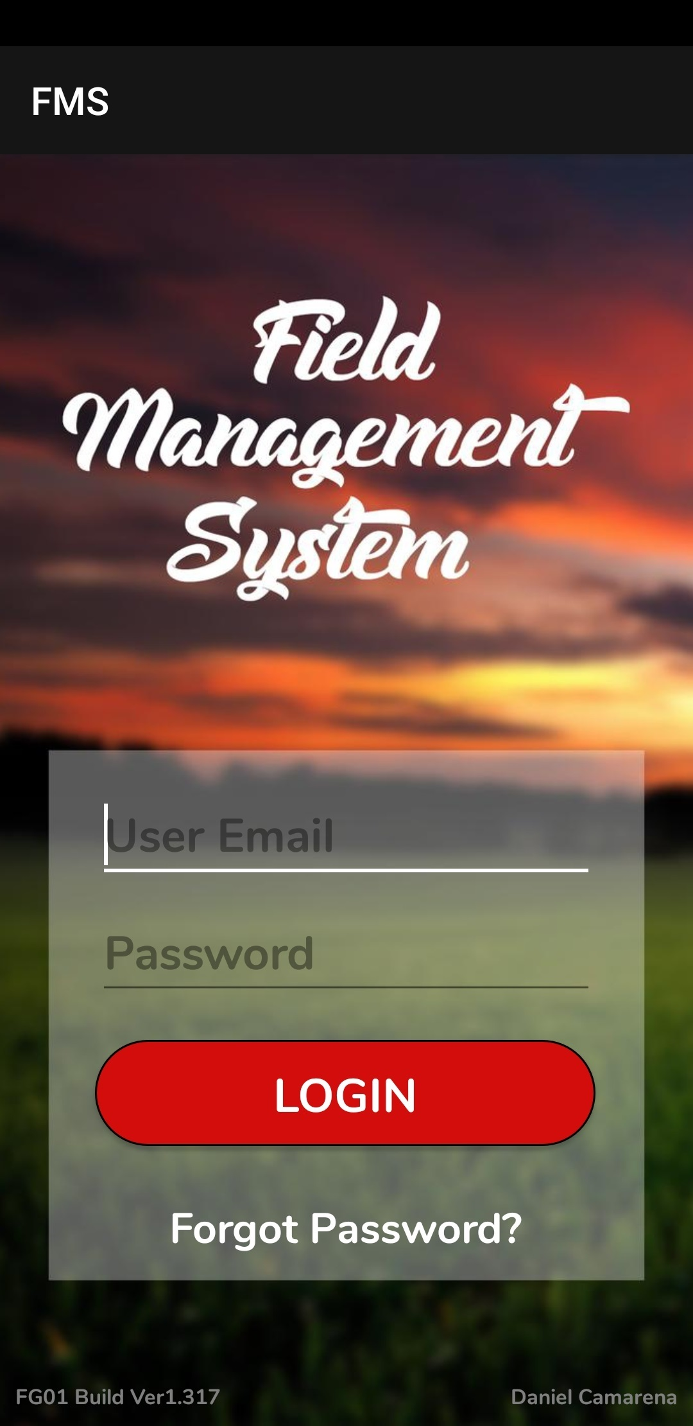
This is the login screen

Slide 3
This is the login screen
The user will enter their registered email address and password to gain access to the application

Slide 4
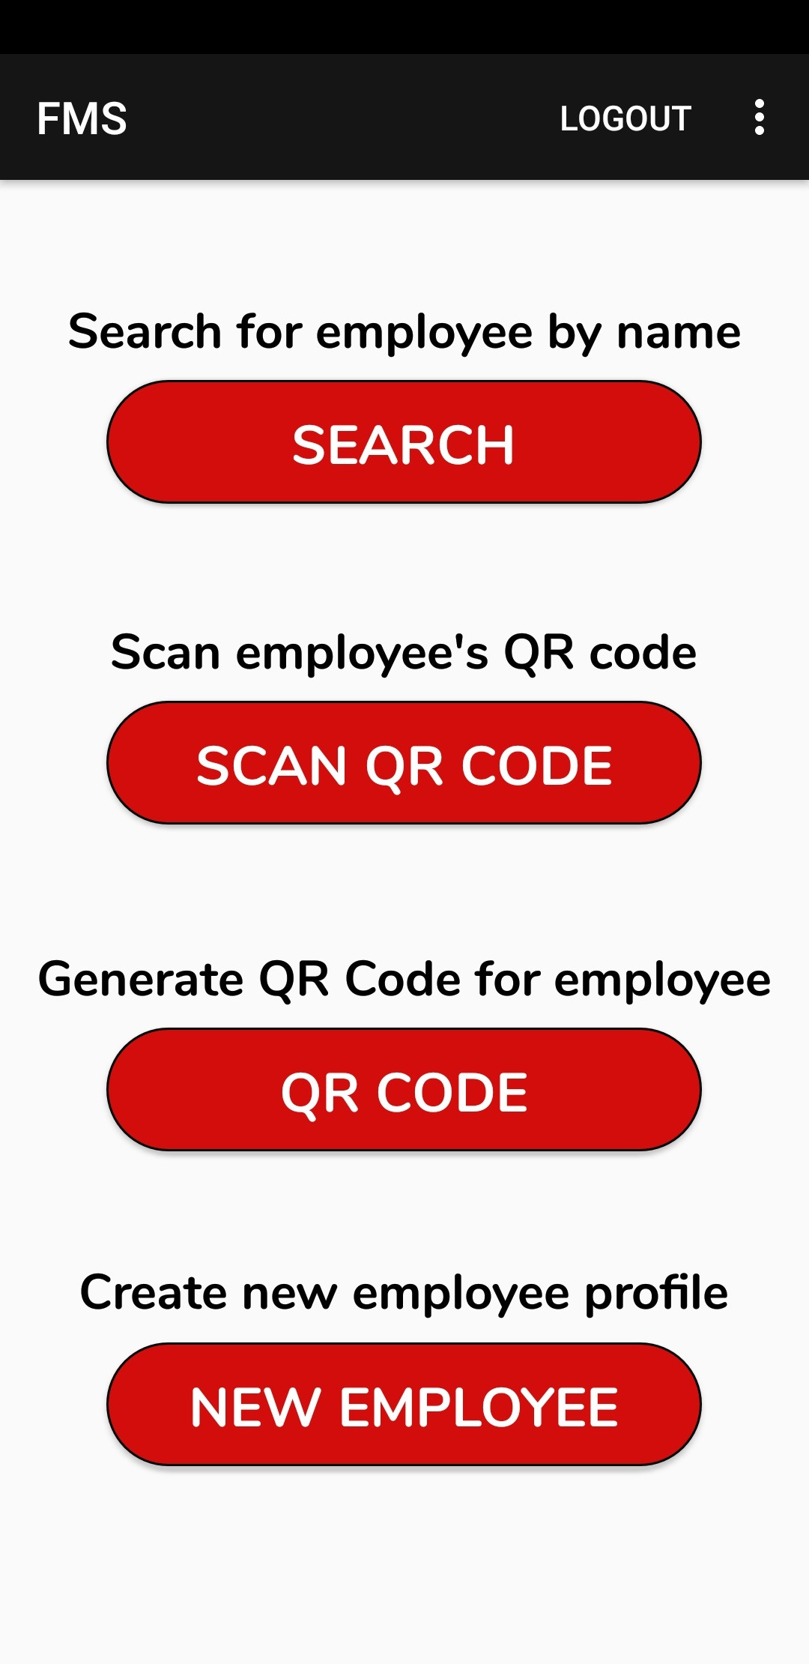
Once logged in, the user will be prompted with the following options

Slide 5
Let’s start at the bottom with NEW EMPLOYEE

Slide 6
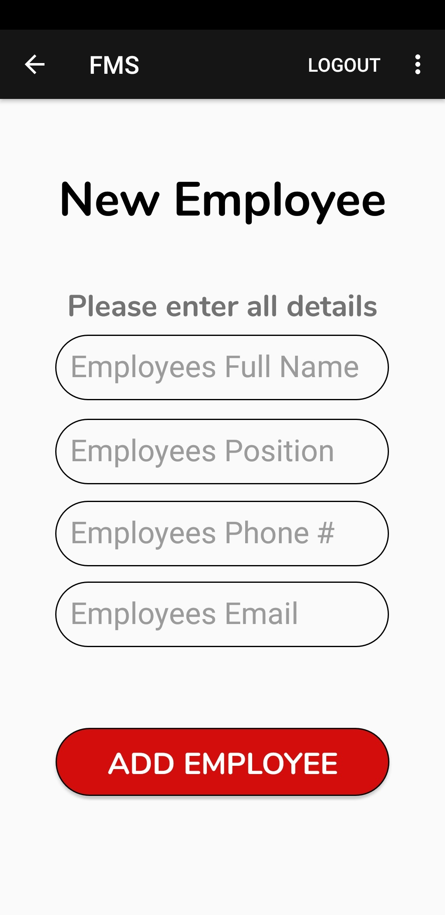
To create a new employee profile, the user must enter all details for their employee

Slide 7
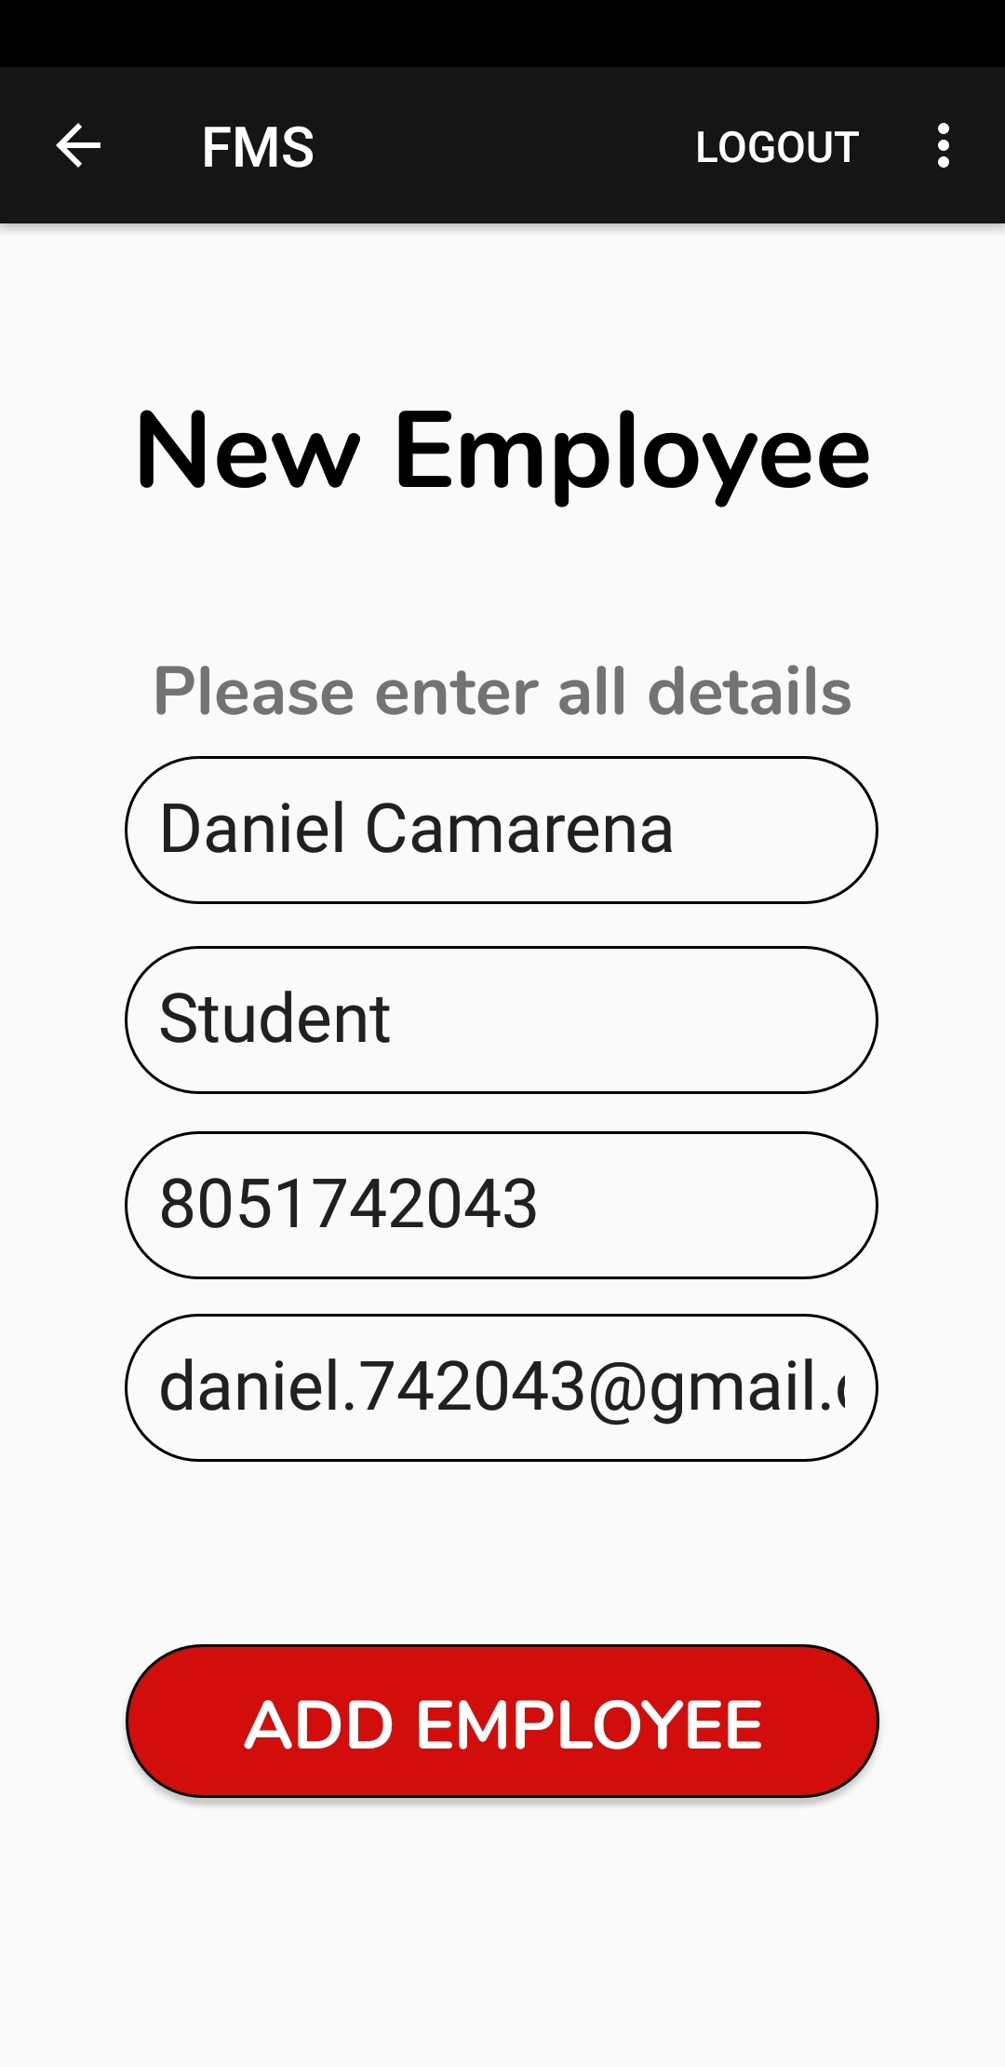
Once all details are filled in, simply press the “ADD EMPLOYEE” button and the profile will be added to the database

Slide 8
Back on the main screen

Slide 9
Let’s move onto generating a QR Code for the new employee profile. To do so, the user will press the “QR CODE” button

Slide 10
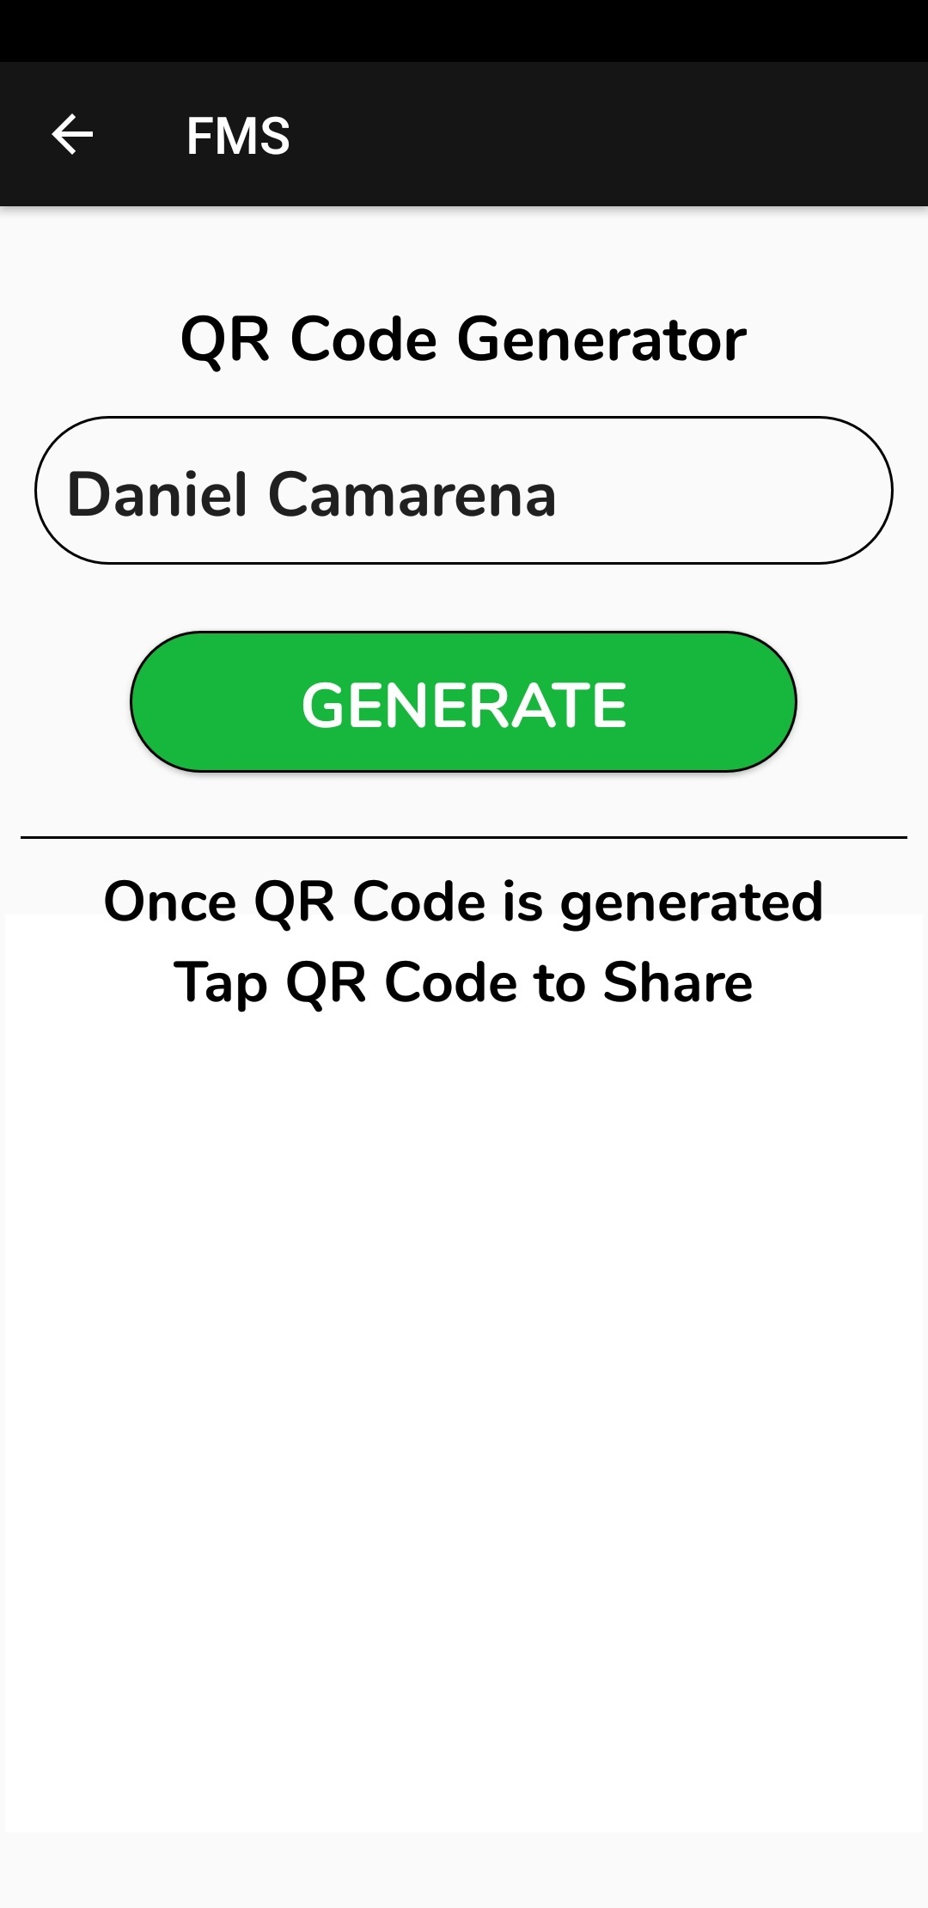
On this screen a QR Code can be generated. If the user needs to go back, simply press the back arrow on the upper left hand corner

Slide 11
Enter the employee’s full name. Then press the “GENERATE” button

Slide 12
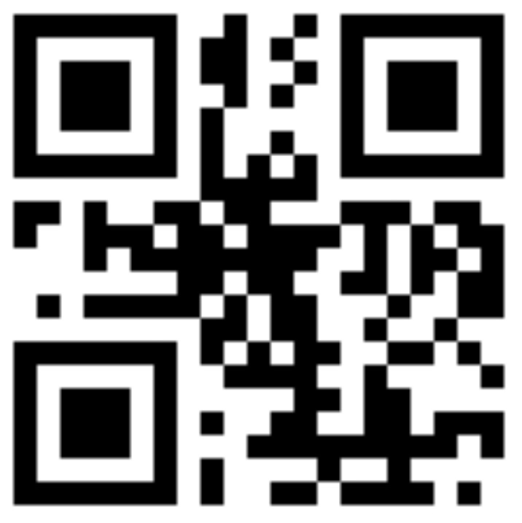
Enter the employee’s full name. Then press the “GENERATE” button

Slide 13
Enter the employee’s full name. Then press the “GENERATE” button
The QR Code can be sent by text or email by tapping the QR Code

Slide 14
Now that the new employee profile and QR Code have been created, it can now be scanned. Press the “SCAN QR CODE” button

Slide 15
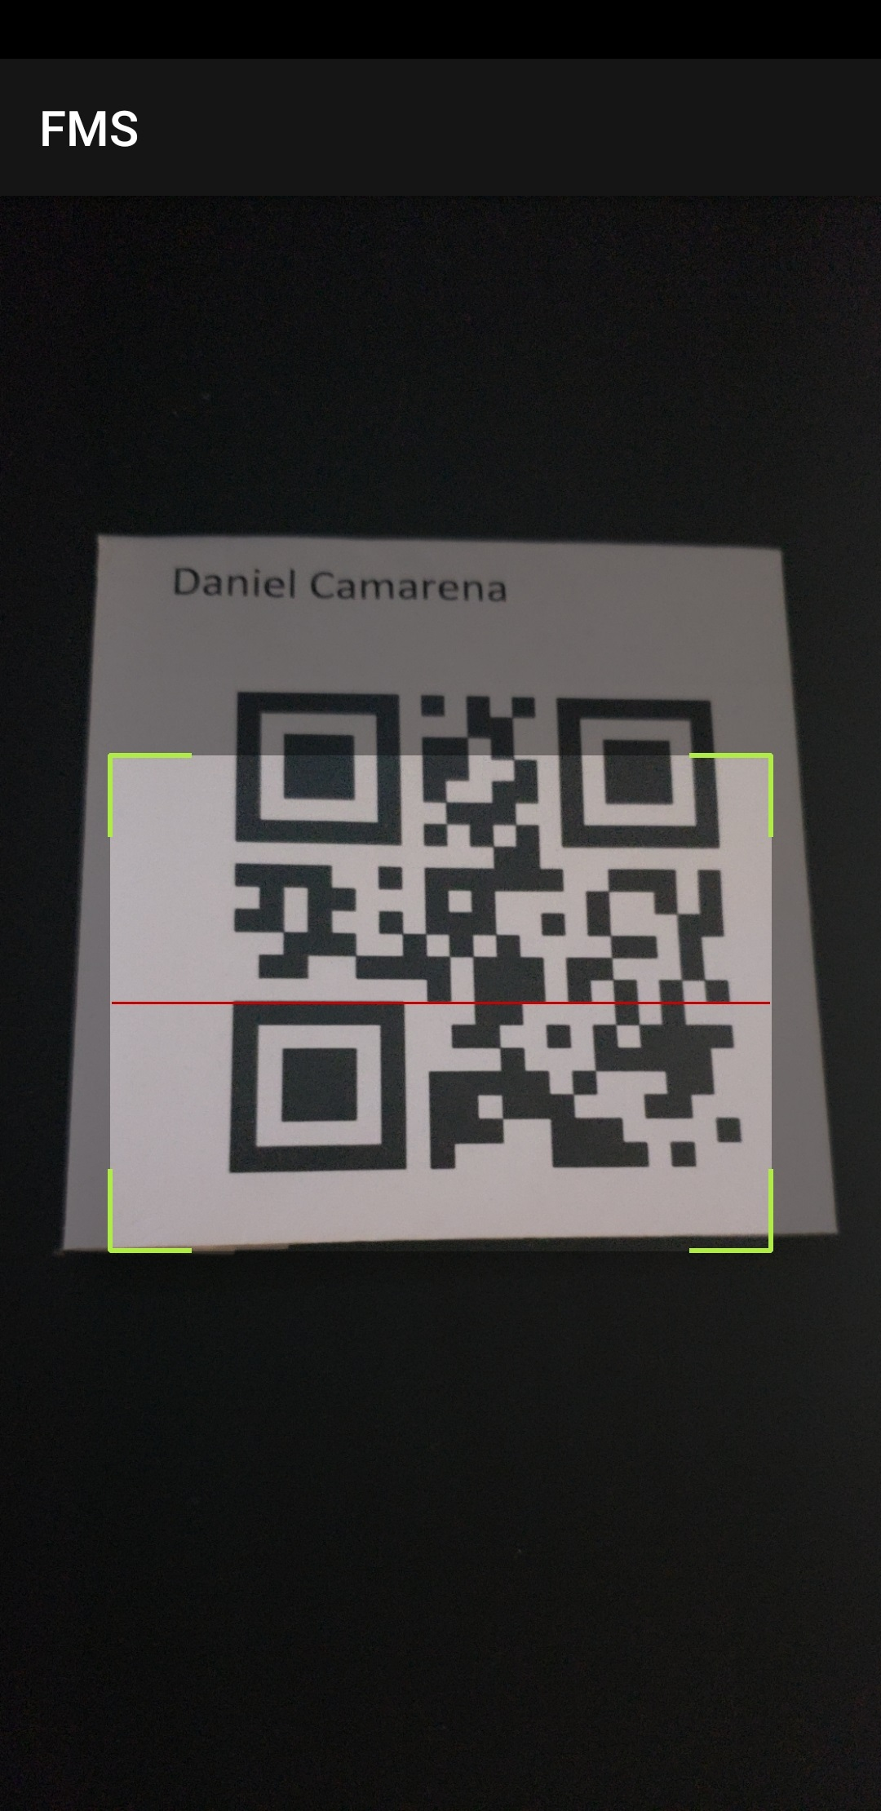
When the “SCAN QR CODE” button is pressed, the camera will open. Aim the camera at the QR Code so it’s inside the target box

Slide 16
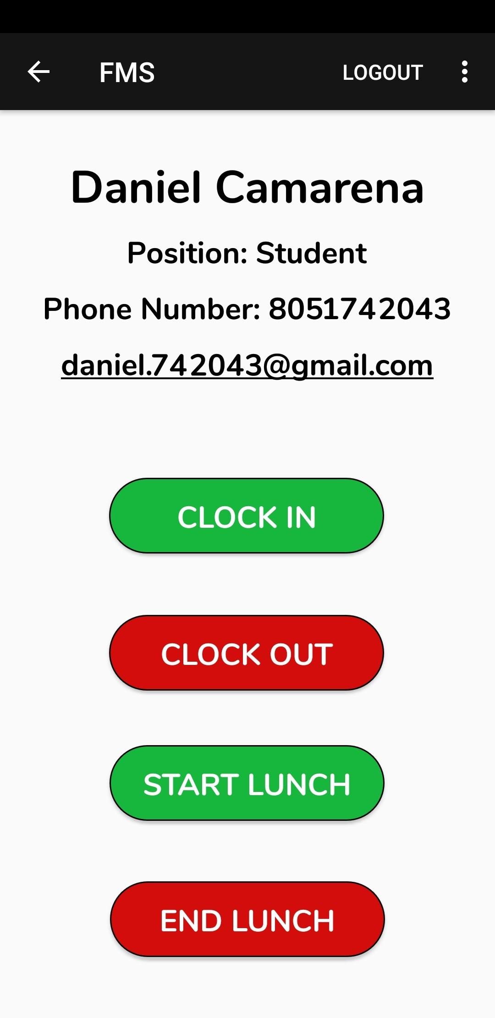
When the QR Code is detected by the application, the corresponding employee profile will be brought up

Slide 17
Not only is the employee profile displayed, but time functions as well

Slide 18
From here, the user can call the employee by tapping on the “Phone Number” portion. An email can also be composed by tapping on the employee’s email

Slide 19
From here, the user can call the employee by tapping on the “Phone Number” portion. An email can also be composed by tapping on the employee’s email
Additionally, the user can clock in or clock out the employee. The current time will be sent to the company wide timesheet

Slide 20
From here, the user can call the employee by tapping on the “Phone Number” portion. An email can also be composed by tapping on the employee’s email
The timesheet can be viewed by tapping on the sub menu(3 dots) on the upper right hand corner
Additionally, the user can clock in or clock out the employee. The current time will be sent to the company wide timesheet

Slide 21
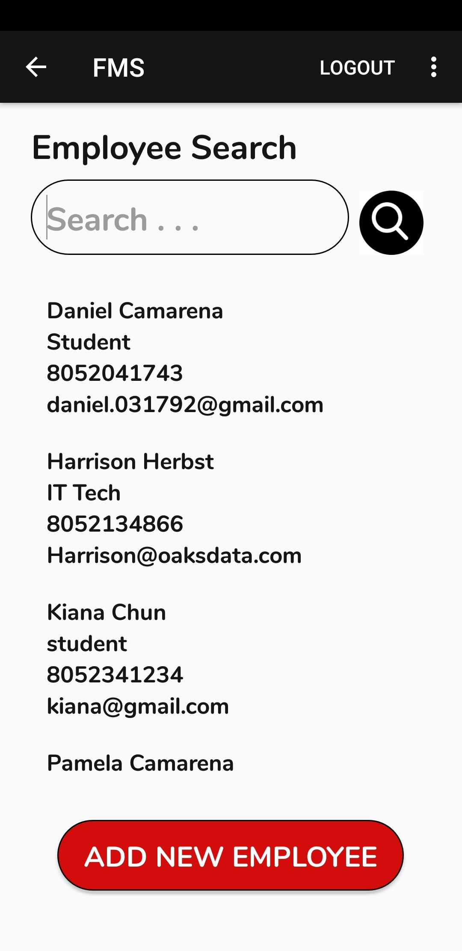
Clicking the back button on the employee profile screen will take the user to the “Employee Search” screen. The search can also be accessed from the main screen by pressing the “SEARCH” button

Slide 22
In the “Employee Search” bar, an employee name can be entered to search for an employee profile. This is an alternate method for accessing an employee profile if the employee does not have their QR Code. If nothing is entered, it will display all the employee profiles in the database

Slide 23
Long pressing an employee profile will bring up the delete dialog box. Pressing yes will delete the profile from the database

Slide 24
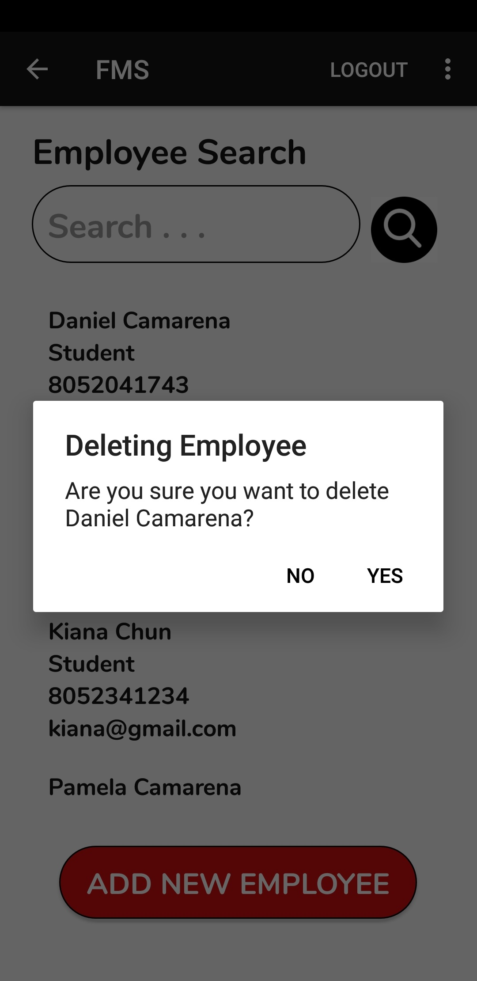
Long pressing an employee profile will bring up the delete dialog box. Pressing “Yes” will delete the profile from the database

Slide 25
Back on the main screen, pressing the 3 dots on the upper right hand corner will display the following menu

Slide 26
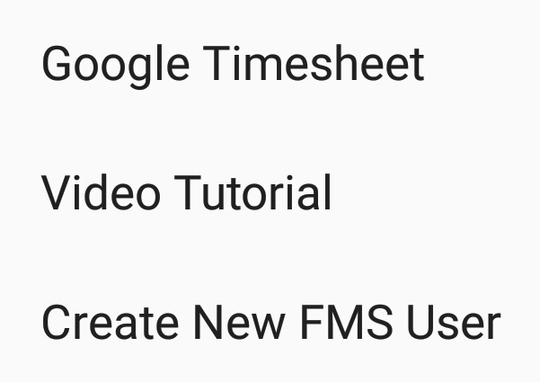
Back on the main screen, pressing the 3 dots on the upper right hand corner will display the following menu

Slide 27
Selecting “Google Timesheet” will take the user to the following web page
Back on the main screen, pressing the 3 dots on the upper right hand corner will display the following menu

Slide 28
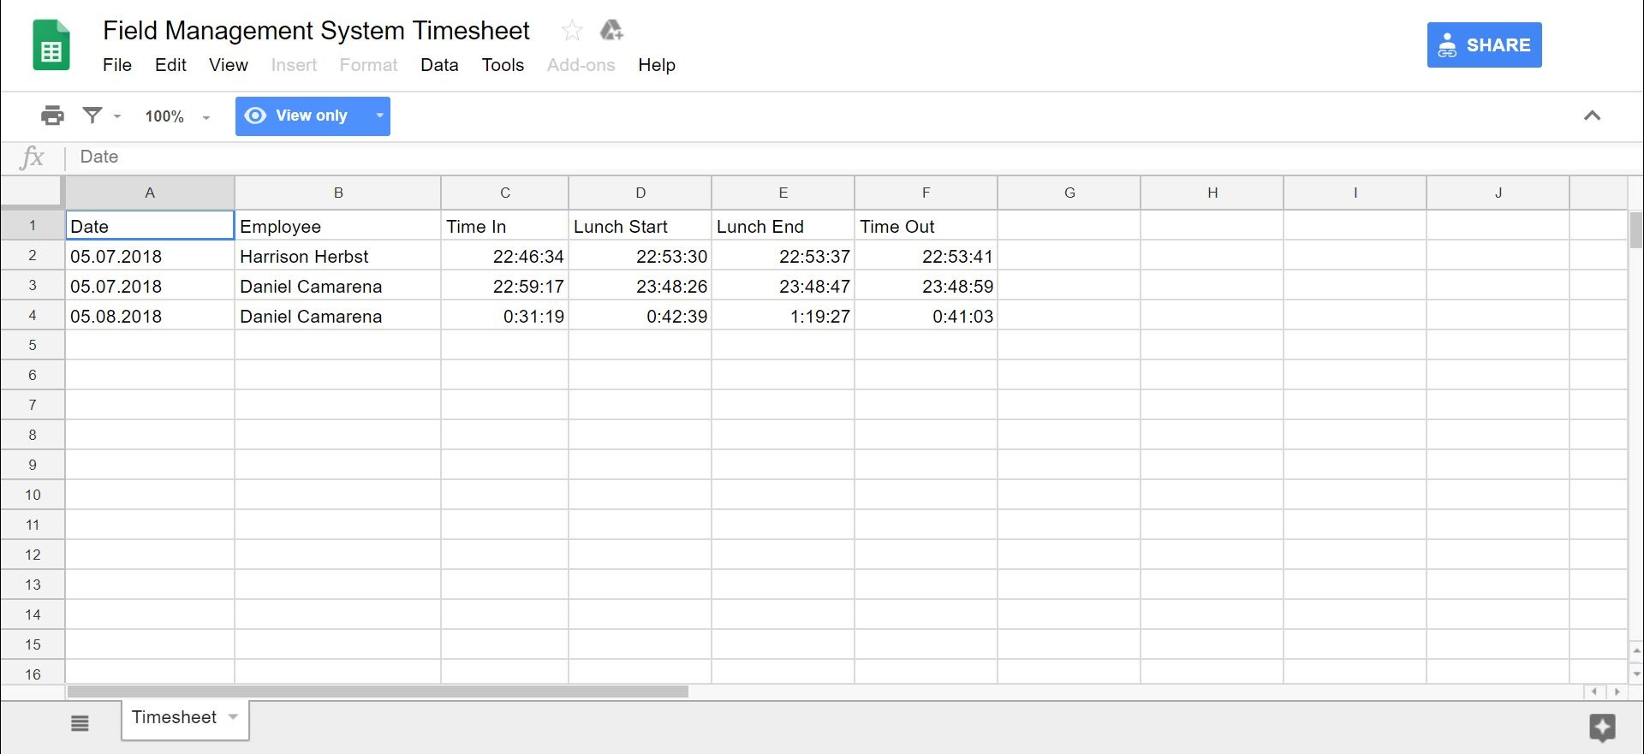
This is the Excel Timesheet that contains all employee hours. This spreadsheet can be accessed and modified from any browser with the proper link

Slide 29
Back in the sub menu, selecting “Video Tutorial” will take the user to this video on YouTube

Slide 30
Selecting “Create New FMS User” will take the user to the following screen

Slide 31
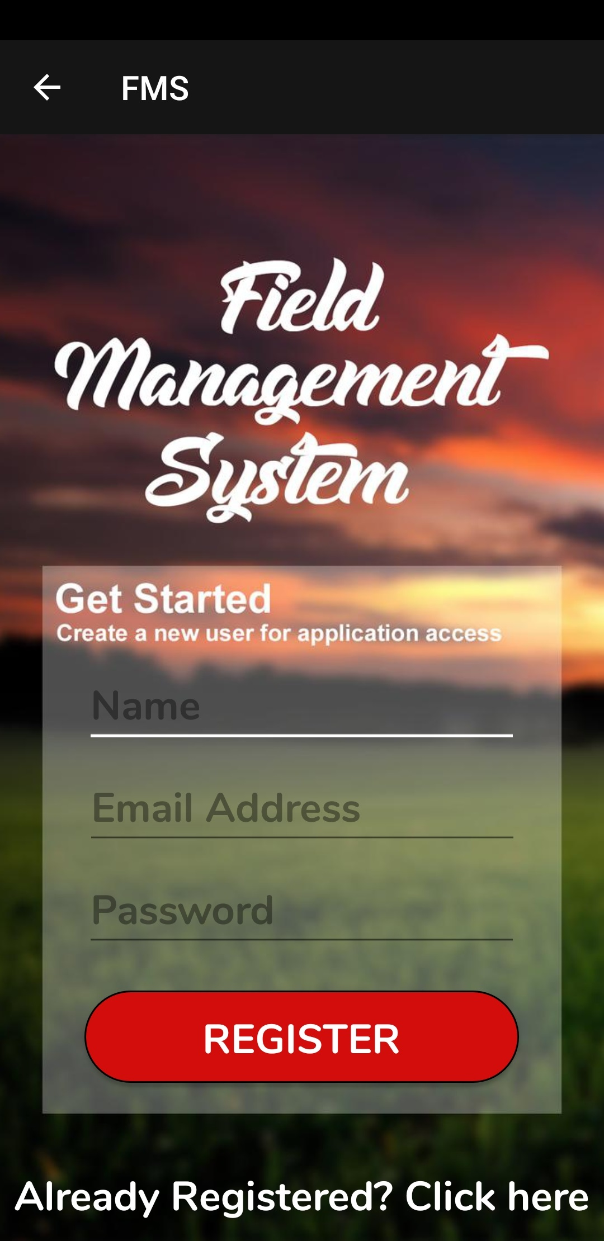
On this screen, the user can create additional users that can access the FMS application. Once all details are filled, an email verification will be sent to the entered email address. The new user must click and verify their account with Google Firebase in order to gain access to the FMS application

Slide 32
Additionally, if a user forgets their password they can press the “Forgot Password?” on the login screen to reset their password

Slide 33
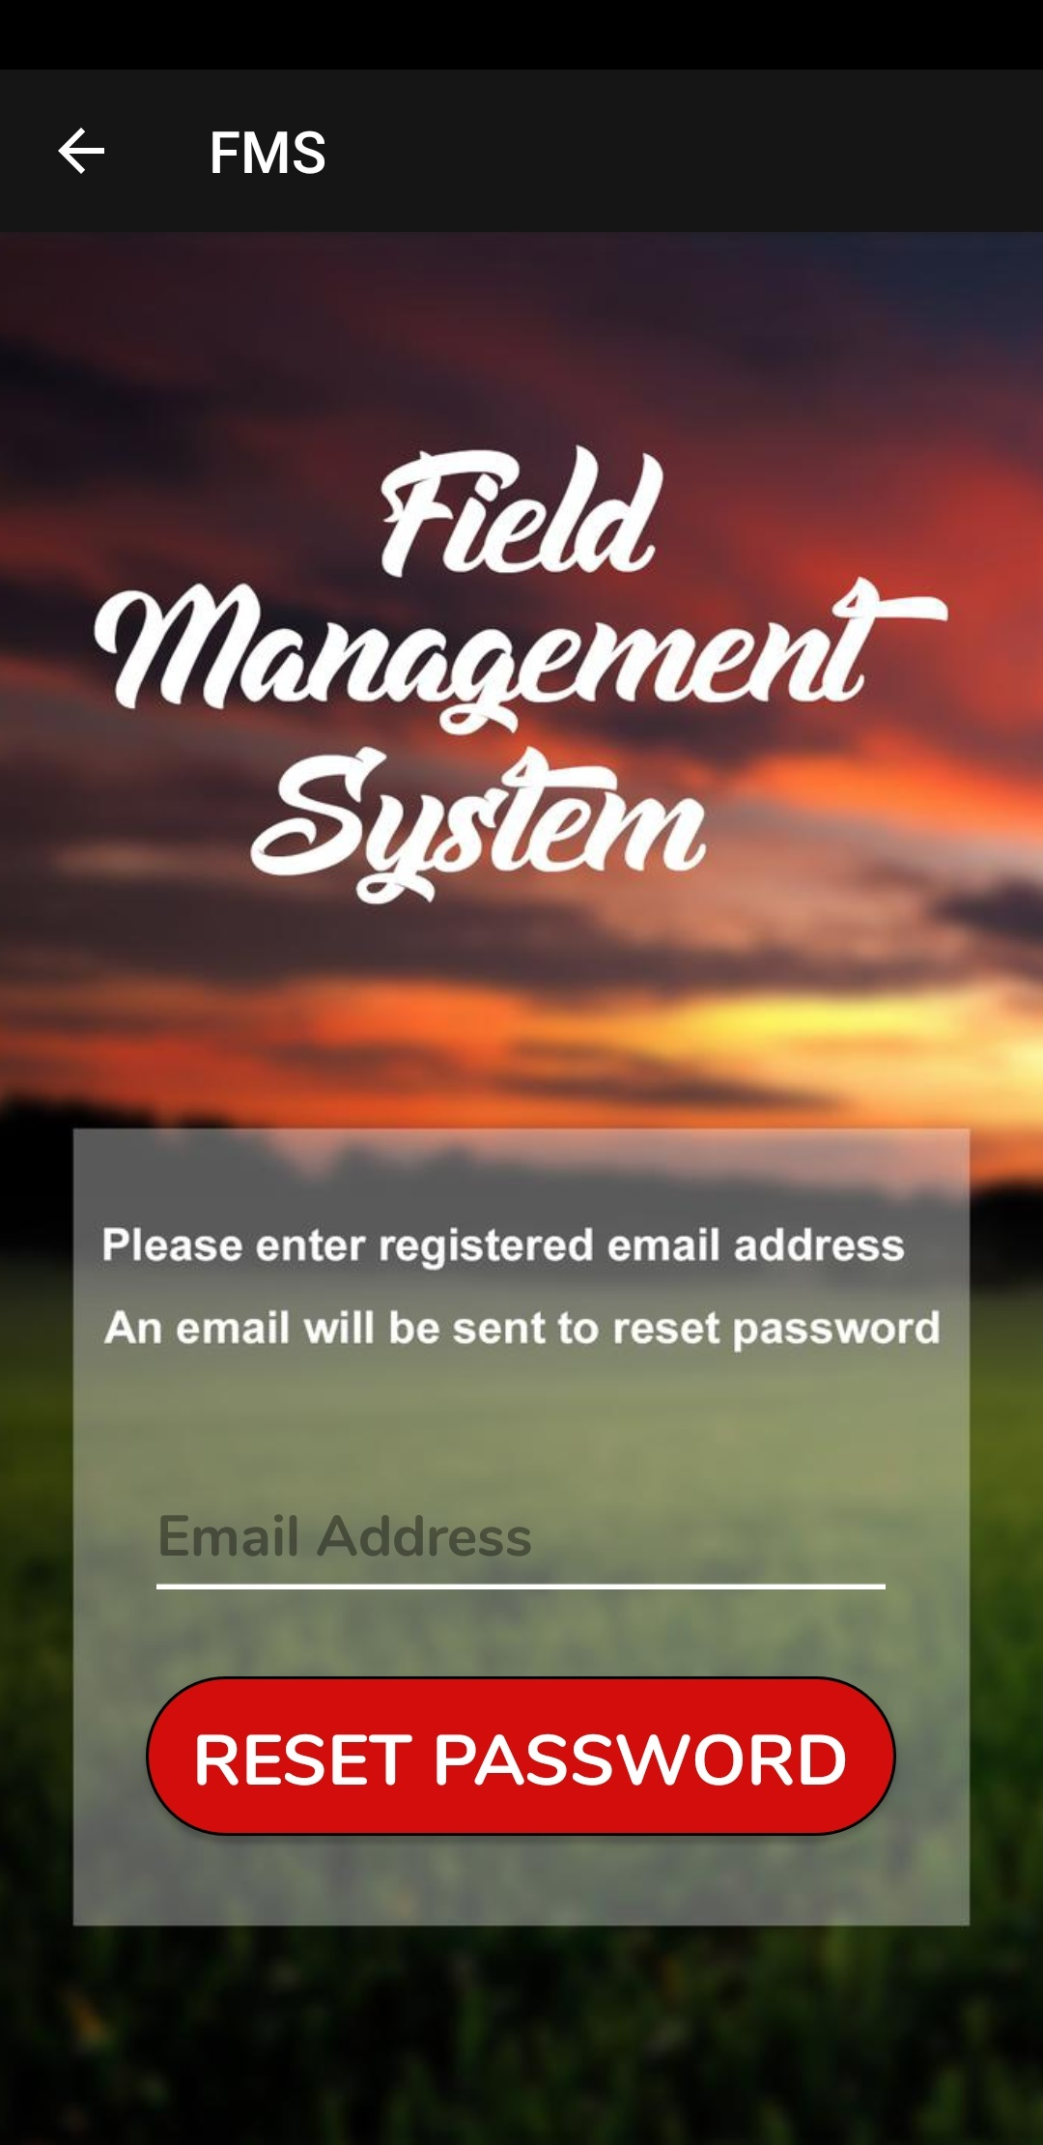
To user will be taken to this screen, where they can enter their registered email address. A reset password link will be sent to their email account by Google’s Firebase

Slide 34
Thank you for watching!

